Slide 1

Graduation Project: Benefit Trading

Slide 2

The team
Yuval Ofek – Software Developer at Intel Corp, and 3rd year Computer Science student.
Dan Davidovich – Officer in Flotilla 13 with the rank of major and 3rd year Computer Science student.
Idan Asayag - Frontend Developer Student at Elta Systems Ltd, and 3rd year Computer Science student.
Omer Ben David - Software Developer Student at IDF, and 3rd year Computer Science student.
Lior Hassin – 3rd year Computer Science student.

Slide 3
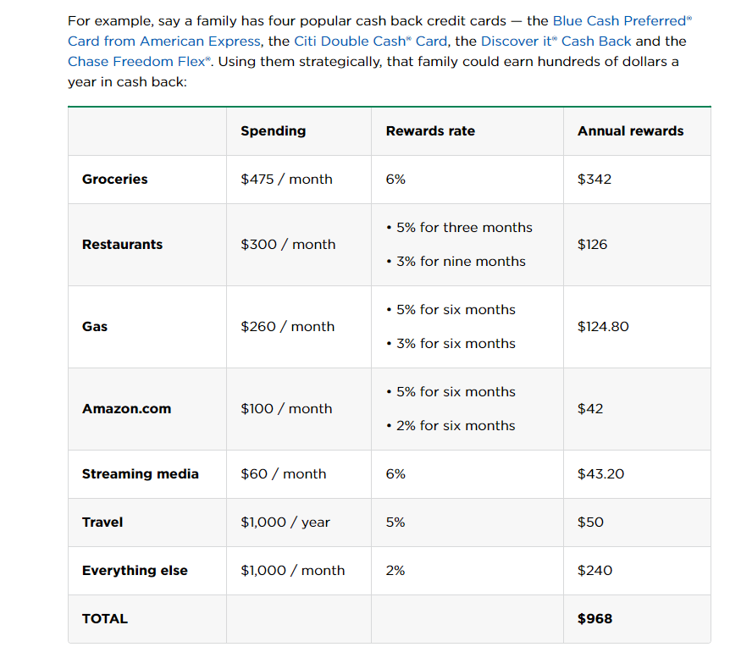
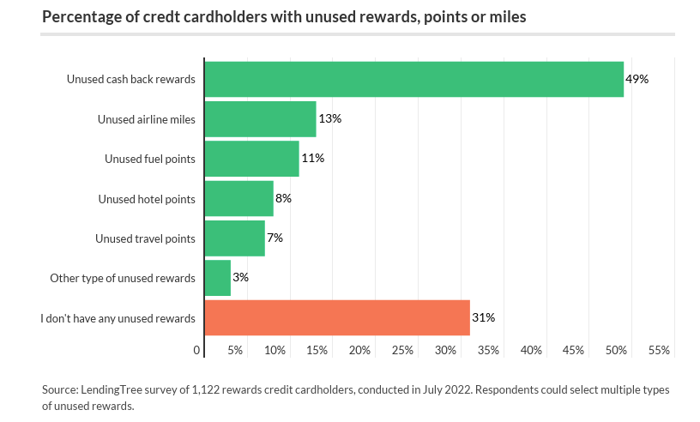
The problem
Nearly 7 in 10 Rewards Credit Cardholders Sitting on Unused Cash Back, Points or Miles
As of 2022, 82% of US residents hold at least one credit card (3 cards in average).
How many credit cards do americans have | Forbes
$2278 / month
Source
Why every purchase should be on a credit card | NerdWallet

Slide 4

The solution
Rewards Market
Users can list their unused points, miles, and perks from various loyalty programs for sale.
Buyers can browse available rewards, filter by program, and purchase what best suits their needs.
A real-time pricing mechanism adjusts the value of points and miles based on supply and demand, similar to a stock market. This ensures fair and transparent pricing.
Transactions are secure, with a built-in escrow system that ensures the transfer of points or miles only occurs once payment is confirmed.
There is a transaction fee of 0.5% and subscription fee of $2 per month.

Slide 5
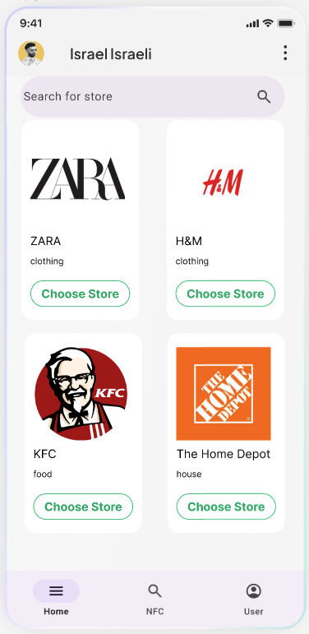
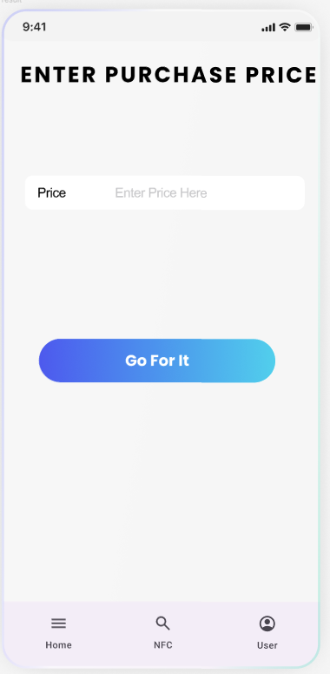
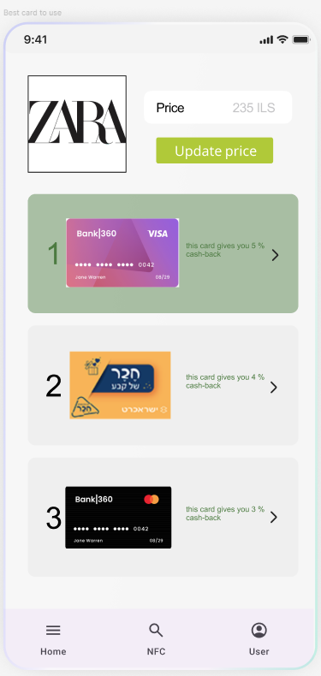
The solution

Slide 6
Competition
Brokers that helps people to sell their miles and points - it is unsecure (some of them get the points without paying the seller.

Slide 7
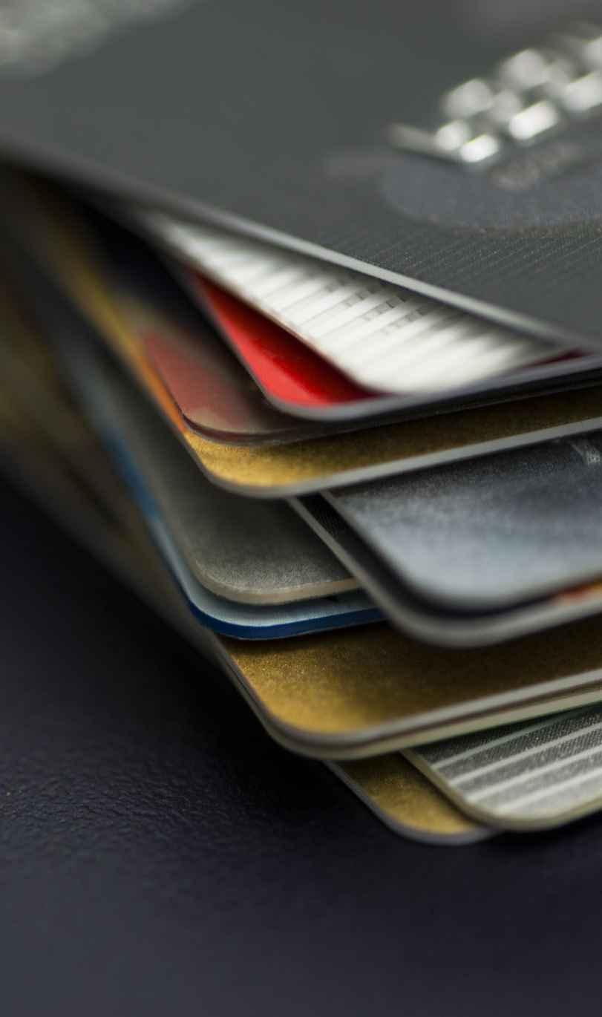
Market
In 2023, the total value of digital payment transactions in the U.S. was approximately $2.04 trillion (2,040,000,000,000 USD). The digital payments sector is expected to continue growing at an annual rate of 14.66% through 2027​.
About 80% of credit card holders possess more than one credit card - amounts to approximately 265.6 million people.
3 is the average number of cards for every person who uses credit cards.
Around 50% of American credit card holders reported actively utilizing the rewards associated with their credit cards.
*How Do Consumers Feel About Credit Cards?

Slide 8

Join us in our mission to help millions earn they money back from their unused perks.

